Slide 1
Tool Command Language
designed by John Ousterhout
First appeared in 1998
Developer TCL core team

Slide 2
What is TCL…?
Tcl (pronounced “tickle") is a high-level, general purpose, interpreted, dynamic programming language.
It was designed with the goal of being very simple but powerful .Tcl casts everything into the mold of a command, even programming constructs like variable assignment and procedure definition.
Tcl supports multiple programming paradigms, including object-oriented, imperative and functional programming or procedural styles.
there are lot of preferable features in tcl that makes user to access and understand the code.

Slide 3
Features of TCl
All data types can be manipulated as strings, including source code. Internally, variables have types like integer and double, but converting is purely automatic.
All commands defined by Tcl itself generate error messages on incorrect usage.
Similar to all other softwares TCL also have the same uses but very simple to use.
Runs on Windows, Mac OS X, Linux, and virtually every variant of unix.
Create new control structures and commands.
Access variables in the calling procedure's context.
Execute code in the calling procedure's context.
The other main important feature is regular expression command.

Slide 4
Basic commands
Puts
Gets
Set
if
While
Foreach
Break
Continue
Return
Expr
Regexp
Array
Proc
Above are the main and commonly used commands in the tcl.

Slide 5
Set :- set command is used to assign the variable in the TCL
Set x 24
The value 24 is assigned to the x
Puts :- puts command is used to print the line that is given in its quotes.
Puts “ the value is $x”
Puts “ welcome to laksh semiconductors ”
Output :-
24
welcome to laksh semiconductors
Gets :- gets command is used to give input to the tool to evaluate the code (gets stdin)
Gets stdin somevariable
What ever the variable we give will be stored in the somevariable…

Slide 6
Example code
Set x 25
Puts “enter the value of y ”
Gets stdin y
Puts “$x,$y”
output :-
Enter the value of y
6
25,6

Slide 7
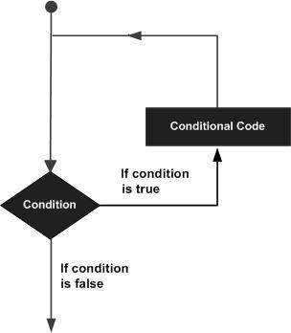
Loops concept….
There may be a situation, where you need to execute a block of code several number of times. In general, statements are executed sequentially: The first statement in a function is executed first, followed by the second, and so on.
Programming languages provide various control structures that allow for more complicated execution paths.
A loop statement allows us to execute a statement or group of statements multiple times and following is the general form of a loop statement in most of the programming languages

Slide 8
While loop
while loop Repeats a statement or group of statements while a given condition is true. It tests the condition before executing the loop body.
Syntax :–
While {condition} {
Statements…
…
}
For loop
Executes a sequence of statements multiple times and abbreviates the code that manages the loop variable.
Syntax:-
For {initialisation} {condition} {increment} {
Statements….
}

Slide 9
Loop control statements
Break statement
Terminates the loop or switch statement and transfers execution to the statement immediately following the loop or switch.
Syntax :-
Set a 10
while {$a < 20 } {
puts "value of a: $a"
incr a
if { $a > 15} {
# terminate the loop using break statement
break
}
}

Slide 10
Continue statement
Causes the loop to skip the remainder of its body and immediately retest its condition prior to reiterating.
Example code :-
Set a 10
while { $a < 20 } {
if { $a == 15} {
#skip the iteration
incr a
continue
}
puts "value of a: $a"
incr a
}

Slide 11
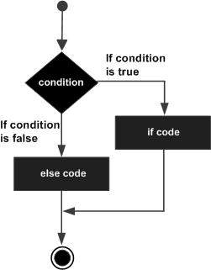
If-else statements
An if statement can be followed by an optional else statement, which executes when the Boolean expression is false.

Slide 12
syntax
if {boolean_expression} {
# statement(s) will execute if the boolean expression is true
} else {
# statement(s) will execute if the boolean expression is false
}
If the Boolean expression evaluates to true, then the if block of code will be executed, otherwise else block of code will be executed.
Tcl language uses the expr command internally and hence it's not required for us to use expr statement explicitly.

Slide 13
Arrays …
An array is a systematic arrangement of a group of elements using indices. The syntax for the conventional array is shown below.
set ArrayName(Index) value
Example code :-
set names(1) Jane
set names(2) Tom
set names(3) Elisabeth
set names(4) Robert
set names(5) Julia
set names(6) Victoria
puts [array size names]
puts $names(1)
puts $names(2)
puts $names(6)
Output:-
6
Jane
Tom
victoria

Slide 14
Strings
A string is a sequence of characters.
String in Tcl, unlike in other languages, need not be always enclosed within double quotes. They are necessary only if we have a space between words.
Tcl is a string based language. It provides a rich set of commands for manipulating strings.
set myVariable hello
puts $myVariable
set myVariable "hello world"
puts $myVariable
set myVariable {hello world}
puts $myVariable
Output :-
Hello
Hello world
Hello world

Slide 15
lists
List is one of the basic data-type available in Tcl. It is used for representing an ordered collection of items. It can include different types of items in the same list. Further, a list can contain another list.
An important thing that needs to be noted is that these lists are represented as strings completely and processed to form individual items when required. So, avoid large lists and in such cases; use array.
set colorList1 {red green blue}
set colorList2 [list red green blue]
set colorList3 [split "red_green_blue" _]
puts $colorList1
puts $colorList2
puts $colorList3

Slide 16
Regular expression
The "regexp" command is used to match a regular expression in Tcl. A regular expression is a sequence of characters that contains a search pattern. It consists of multiple rules and the following table explains these rules and corresponding use.
Syntax:-
Regexp “ keysearch” $n
Where $n is the number of line that the keysearch is found…
Keysearch is the string or the word we want to match…

Slide 17
Procedures
Procedures are nothing but code blocks with series of commands that provide a specific reusable functionality.
It is used to avoid same code being repeated in multiple locations.
Procedures are equivalent to the functions used in many programming languages and are made available in Tcl with the help of proc command.
Syntax :-
proc procedureName {arguments} {
body
}

Slide 18
Files
Tcl supports file handling with the help of the built in commands open, read, puts, gets, and close.
When we access files first we need to open the file to do any operations on the file.
At the end we need to always close the file.
Basic syntax:-
set filename [open “path” mode]
Open is used to open the file that exsit in the given path .
Mode is the type of operation i.e write,read,append.

Slide 19
Basic linux commands
Linux is Mainly used in servers. About 90% of the internet is powered by Linux servers. This is because Linux is fast, secure, and free! The main problem of using Windows servers are their cost. This is solved by using Linux servers. The OS that runs in about 80% of the smartphones in the world, Android, is also made from the Linux kernel. Most of the viruses in the world run on Windows, but not on Linux!
Basic command
pwd
When you first open the terminal, you are in the home directory of your user. To know which directory you are in, you can use the “pwd” command. It gives us the absolute path, which means the path that starts from the root. The root is the base of the Linux file system. It is denoted by a forward slash( / ). The user directory is usually something like "/home/username".

Slide 20
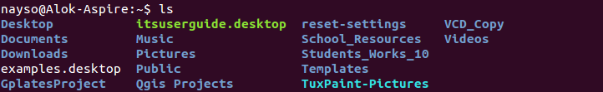
linux
2. ls —
Use the "ls" command to know what files are in the directory you are in. You can see all the hidden files by using the command “ls -a”.

Slide 21
linux
3. cd —
Use the "cd" command to go to a directory. For example, if you are in the home folder, and you want to go to the downloads folder, then you can type in “cd Downloads”. Remember, this command is case sensitive, and you have to type in the name of the folder exactly as it is.
Example:-
Cd /home/vlsi/isspd1700/work/tcl/assignments/

Slide 22
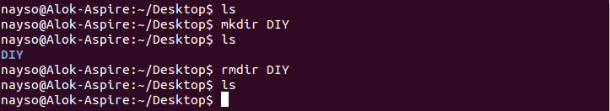
linux
4. mkdir & rmdir —
Use the mkdir command when you need to create a folder or a directory. For example, if you want to make a directory called “DIY”, then you can type “mkdir DIY”. Remember, as told before, if you want to create a directory named “DIY Hacking”, then you can type “mkdir DIY\ Hacking”. Use rmdir to delete a directory. But rmdir can only be used to delete an empty directory. To delete a directory containing files, use rm.

Slide 23


linux
5. Touch —
The touch command is used to create a file. It can be anything, from an empty txt file to an empty zip file. For example, “touch new.txt”.
\
6. cp — Use the cp command to copy files through the command line. It takes two arguments: The first is the location of the file to be copied, the second is where to copy.

Slide 24
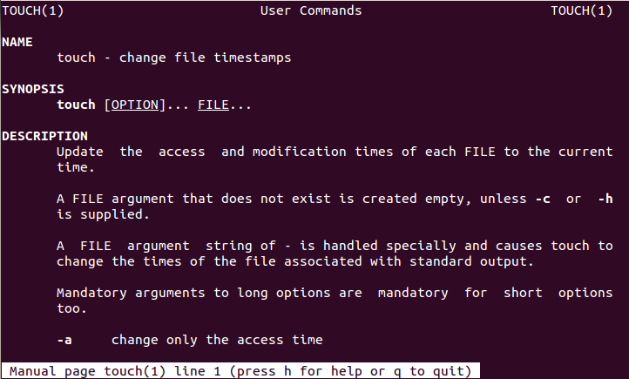
linux
7. man & --help — To know more about a command and how to use it, use the man command. It shows the manual pages of the command. For example, “man cd” shows the manual pages of the cd command. Typing in the command name and the argument helps it show which ways the command can be used (e.g., cd –help).

Slide 25

linux
8. mv —
Use the mv command to move files through the command line. We can also use the mv command to rename a file. For example, if we want to rename the file “text” to “new”, we can use “mv text new”. It takes the two arguments, just like the cp command.

Slide 26

linux
9. locate — The locate command is used to locate a file in a Linux system, just like the search command in Windows. This command is useful when you don't know where a file is saved or the actual name of the file. Using the -i argument with the command helps to ignore the case (it doesn't matter if it is uppercase or lowercase). So, if you want a file that has the word “hello”, it gives the list of all the files in your Linux system containing the word "hello" when you type in “locate -i hello”. If you remember two words, you can separate them using an asterisk (*). For example, to locate a file containing the words "hello" and "this", you can use the command “locate -i *hello*this”.

Slide 27
THANK you

